Slide 1
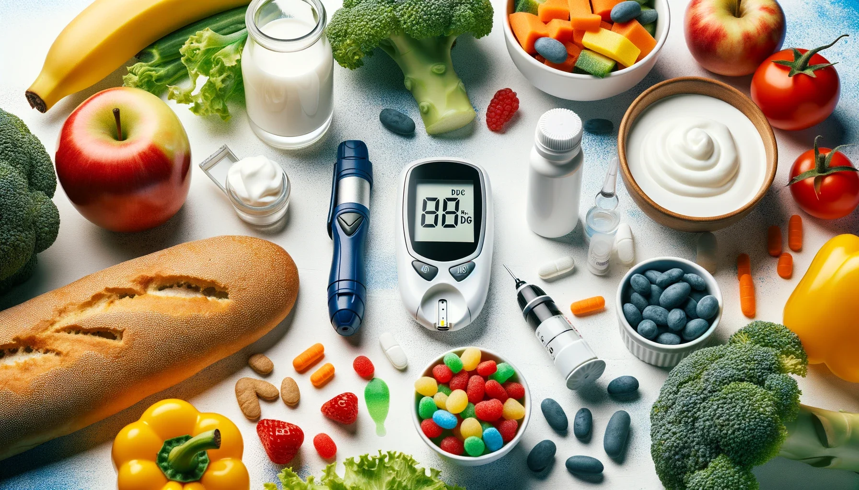
Diabetes Prediction
Balram Bhanu Iyengar
Himaja Kondinollu Rajendra
Prajwal Hemmakki Rathnakar

Slide 2
Agenda
Background and Context
Objective
Data Dictionary | Numerical
Data Dictionary | Categorical
Methods: Models to be Implemented
Methods: Model Evaluation Criteria(1/2)
Methods: Model Evaluation Criteria(2/2)
Exploratory Data Analysis - Notable Results
Results – Logistic Regression
Results – K-NN (K-Nearest Neighbor)
K-NN - Feature Importance
Conclusion

Slide 3
Background and Context
Diabetes is among the most prevalent chronic diseases in the United States, impacting millions of Americans each year and exerting a significant financial burden on the economy.
Diabetes is a serious chronic disease in which individuals lose the ability to effectively regulate levels of glucose in the blood, and can lead to reduced quality of life and life expectancy.
Total: 38.4 million people have diabetes (11.6% of the US population)
Diagnosed: 29.7 million people, including 29.4 million adults
Undiagnosed: 8.7 million people (22.8% of adults are undiagnosed)
Prediabetes
Total: 97.6 million people aged 18 years or older have prediabetes (38.0% of the adult US population)
65 years or older: 27.2 million people aged 65 years or older (48.8%) have prediabetes
Notes:
-Diabetes is among the most prevalent chronic diseases in the United States, impacting millions of Americans each year and exerting a significant financial burden on the economy. Diabetes is a serious chronic disease in which individuals lose the ability to effectively regulate levels of glucose in the blood, and can lead to reduced quality of life and life expectancy. Diabetes is generally characterized by either the body not making enough insulin or being unable to use the insulin that is made as effectively as needed.
-The scale of this problem is also important to recognize. The Centers for Disease Control and Prevention has indicated that as of 2018, 38.4 million Americans have diabetes and 97.6 million have prediabetes. Furthermore, the CDC estimates that 1 in 5 diabetics, and roughly 8 in 10 prediabetics are unaware of their risk. While there are different types of diabetes, type II diabetes is the most common form and its prevalence varies by age, education, income, location, race, and other social determinants of health. Much of the burden of the disease falls on those of lower socioeconomic status as well. Diabetes also places a massive burden on the economy, with diagnosed diabetes costs of roughly $327 billion dollars and total costs with undiagnosed diabetes and prediabetes approaching $400 billion dollars annually.

Slide 4
Objective | Goal | Rationale
Objective: Optimize Diabetes Prediction Model for all age groups
Goal: Minimize False Positives to Avoid Unnecessary Stress and Medical Procedures
Rationale: By reducing false positives, we can:
Avoid causing unnecessary stress and anxiety for healthy individuals
Prevent unnecessary medical procedures and lifestyle changes
Encourage individuals who may be at risk to seek further confirmation and testing
Enable earlier detection and treatment of true diabetes cases in the general population
Notes:
False positives lead to predicting diabetes in healthy individuals, causing unnecessary stress and potentially leading to unnecessary medical procedures or lifestyle changes that could negatively impact their well-being. While early diagnosis is important for managing diabetes effectively, a missed case (false negative) can still be addressed later through lifestyle changes and treatment. Given the high prevalence of undiagnosed diabetes, focusing on reducing false positives allows for broader screening and encourages individuals who might be at risk to seek further confirmation through medical tests. This can lead to earlier detection of true cases in the general population.
The objective is to prioritize minimizing false positives in the diabetes prediction model for all age groups.

Slide 5
Data Dictionary | Numerical
Data Variable | 0 | 1 | 2
Diabetes_012 | No Diabetes | Pre-diabetes | Diabetes
HighBP | No | Yes
HighChol | No | Yes
CholCheck | No | Yes in 5 years
Smoker(Smoked atleast 100 cig in your entire life?) | No | Yes
Stroke(Ever told you had a stroke.) | No | Yes
HeartDiseaseorAttack(coronary heart disease (CHD) or myocardial infarction (MI)) | No | Yes

Slide 6
Data Dictionary | Numerical
Data Variable | 0 | 1 | 2
HvyAlcoholConsump(Heavy drinkers (adult men having more than 14 drinks per week and adult women having more than 7 drinks per week)) | No | Yes
AnyHealthCare | No | Yes
NoDocbcCost(Was there a time in the past 12 months when you needed to see a doctor but could not because of cost?) | No | Yes
Sex | Female | Male

Slide 7
Data Dictionary | Categorical
Data Variable | Definition
GenHlth | Would you say that in general your health is: scale 1-5 1 = excellent 2 = very good 3 = good 4 = fair 5 = poor
MenHlth | Now thinking about your mental health, which includes stress, depression, and problems with emotions, for how many days during the past 30 days was your mental health not good? scale 1-30 days
PhysHlth | Now thinking about your physical health, which includes physical illness and injury, for how many days during the past 30 days was your physical health not good? scale 1-30 days
Income | Income scale (INCOME2 see codebook) scale 1-8 1 = less than $10,000 5 = less than $35,000 8 = $75,000 or more
BMI | Body Mass Index
Age | Age of the patient

Slide 8
Methods: Models to be Implemented
1. Logistic Regression:
Logistic regression is a simple and interpretable model often used for binary classification problems, such as predicting diabetes.
2. K-NN (K-Nearest Neighbors):
The k-nearest neighbors algorithm (KNN) is a method used for classification/regression. In both cases, the input consists of the k closest training examples in the feature space.

Slide 9
Methods: Model Evaluation Criteria(1/2)
Reducing False Positives
Optimize model precision to decrease false positives
Improve generalization and minimize overfitting
Evaluate model performance using:
Accuracy
Precision
Feature importance
Achieved high accuracy of ~85% with focus on increasing precision and accuracy
Notes:
How to reduce this loss i.e the need to reduce False Positives?
Improving generalization and minimizing overfitting would result in improved performance in reducing false positives. The company can look to optimize the precision, as a higher precision increases the possibility of decreasing false positives. Therefore, increasing precision or accurately identifying false positives should be the primary objective.

Slide 10
Methods: Model Evaluation Criteria(2/2)
Error Types and Prioritization
False Positives: Predicting diabetes in healthy individuals, leading to unnecessary stress, financial burden, and potential harm.
False Negatives: Failing to detect diabetes in individuals who show signs and complications, delaying crucial lifestyle changes and medical treatment.
Prioritization: Reducing False Positives is more important if minimizing losses and avoiding unnecessary stress is the primary goal.
Notes:
The model can make two types of wrong predictions:
Predicting that a person can be diagnosed with diabetes when the person doesn't really have diabetes.
Predicting that a person is not diagnosed with diabetes even when the person shows sure signs of diabetes.
Which case is more important?
False Positives: Predicting that a person can be diagnosed with diabetes even when the person is healthy leads to predicting diabetes in patients who are not aware of any contributing factors. This could lead to financial burden and mental stress for the patient. If minimizing losses and avoiding unnecessary stress is more important, reducing false positives is more important.
False Negatives: Predicting that a person is not diagnosed with diabetes even when the person shows all signs and complications of diabetes will cause the person to loose preious time to make lifestyle changes and get necessary medical treatment.

Slide 11
Exploratory Data Analysis - Notable Results
Key Observations:
High Blood Pressure (HighBP): 30% likelihood of diabetes diagnosis
History of Heart Disease/Heart Attack: 35% likelihood of diabetes diagnosis
Sex: Equal likelihood of diabetes diagnosis for males and females
High Cholesterol: 20% likelihood of diabetes diagnosis
Healthcare Access: Less than 20% likelihood of diabetes diagnosis (both with and without access)
Smoking: Greater than 20% likelihood of diabetes diagnosis
Notes:
Observations:
Considering HighBP, around 30% people are diagnosed with diabetes.
People with histoy of heart disease or heart attack have around 35% chances of getting diabetes.
Considering sex, we can see both male and female population are equally diagnosed with diabetes.
People with high cholestrol have a 20% chance of getting diabetes.
People with or without any kind of healthcare have a lesser chance (<20%) chance of getting diabetes.
Smokers show greater than 20% chances of getting diagnosed with diabetes.

Slide 12
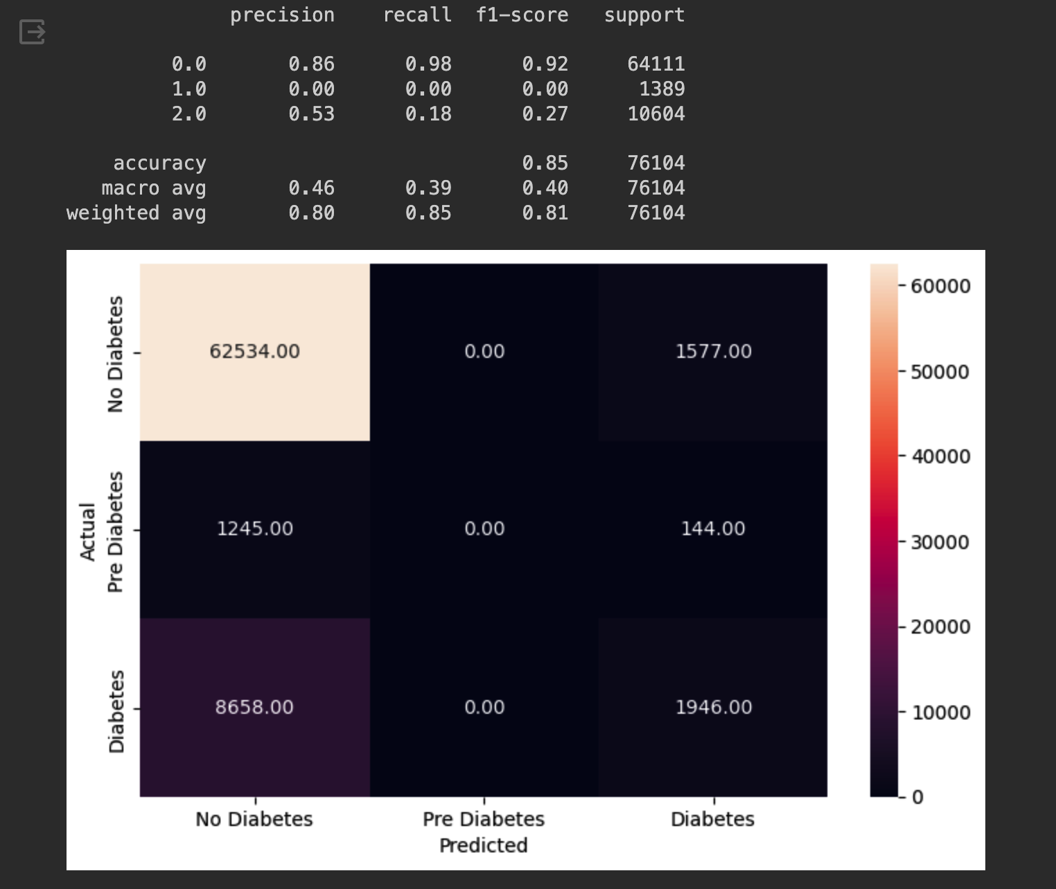
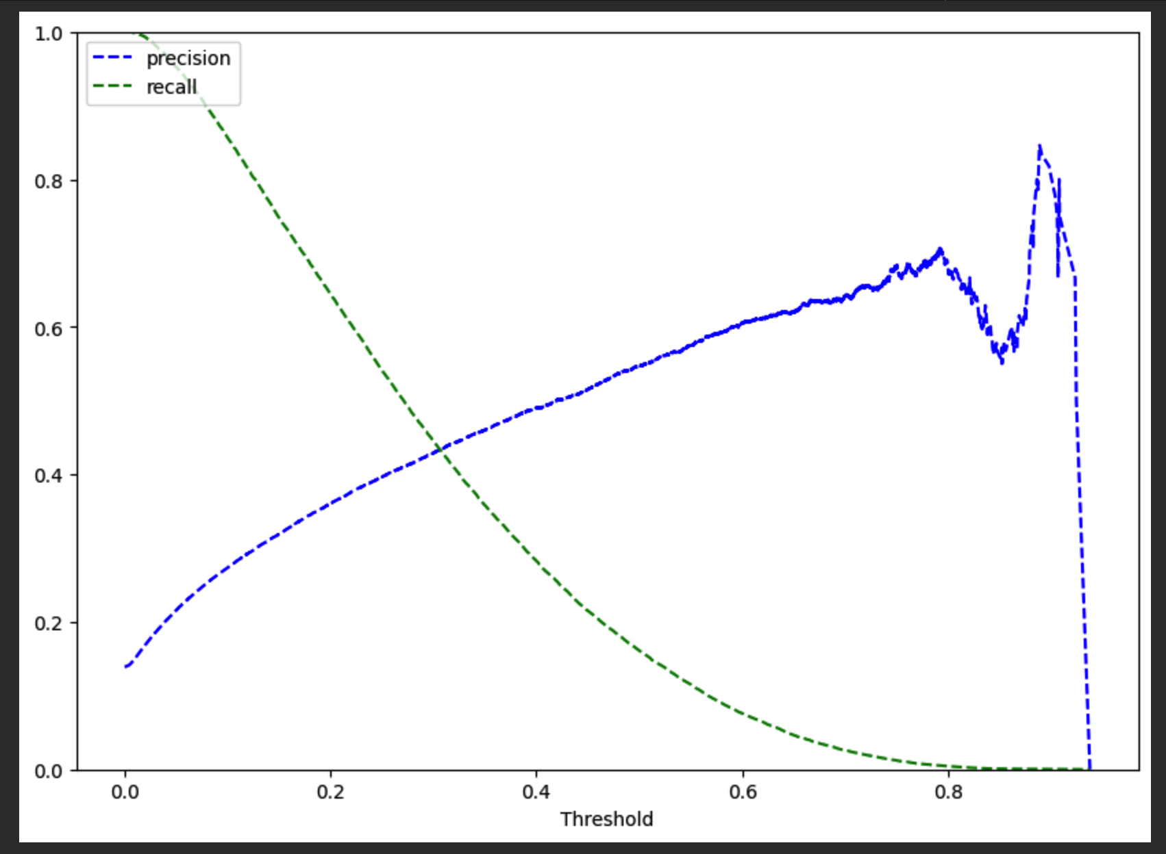
Results – Logistic Regression
The model is giving 85% accuracy on train set as well as test set.
Precision and recall on test set is 53% & 18 % respectively
Precision and recall is balanced at a threshold of ~0.38

Slide 13
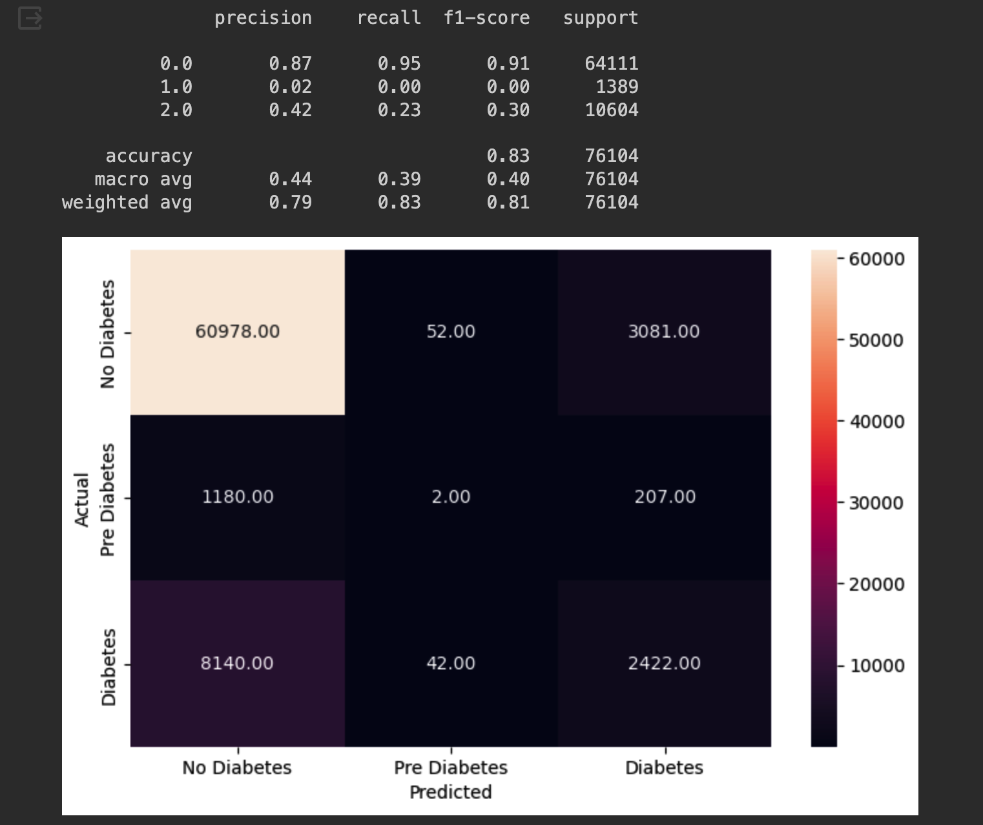
Results – K-NN (K-Nearest Neighbour)
The model is giving 83% accuracy on test set.
Precision for 0 (no diabetes) is 87%, 1 (pre diabetes) is 2%, and 2 (diabetes) is 42%
Recall for 0 (no diabetes) is 95%, 1 (pre diabetes) is 0, 2 (diabetes) is 23%

Slide 14
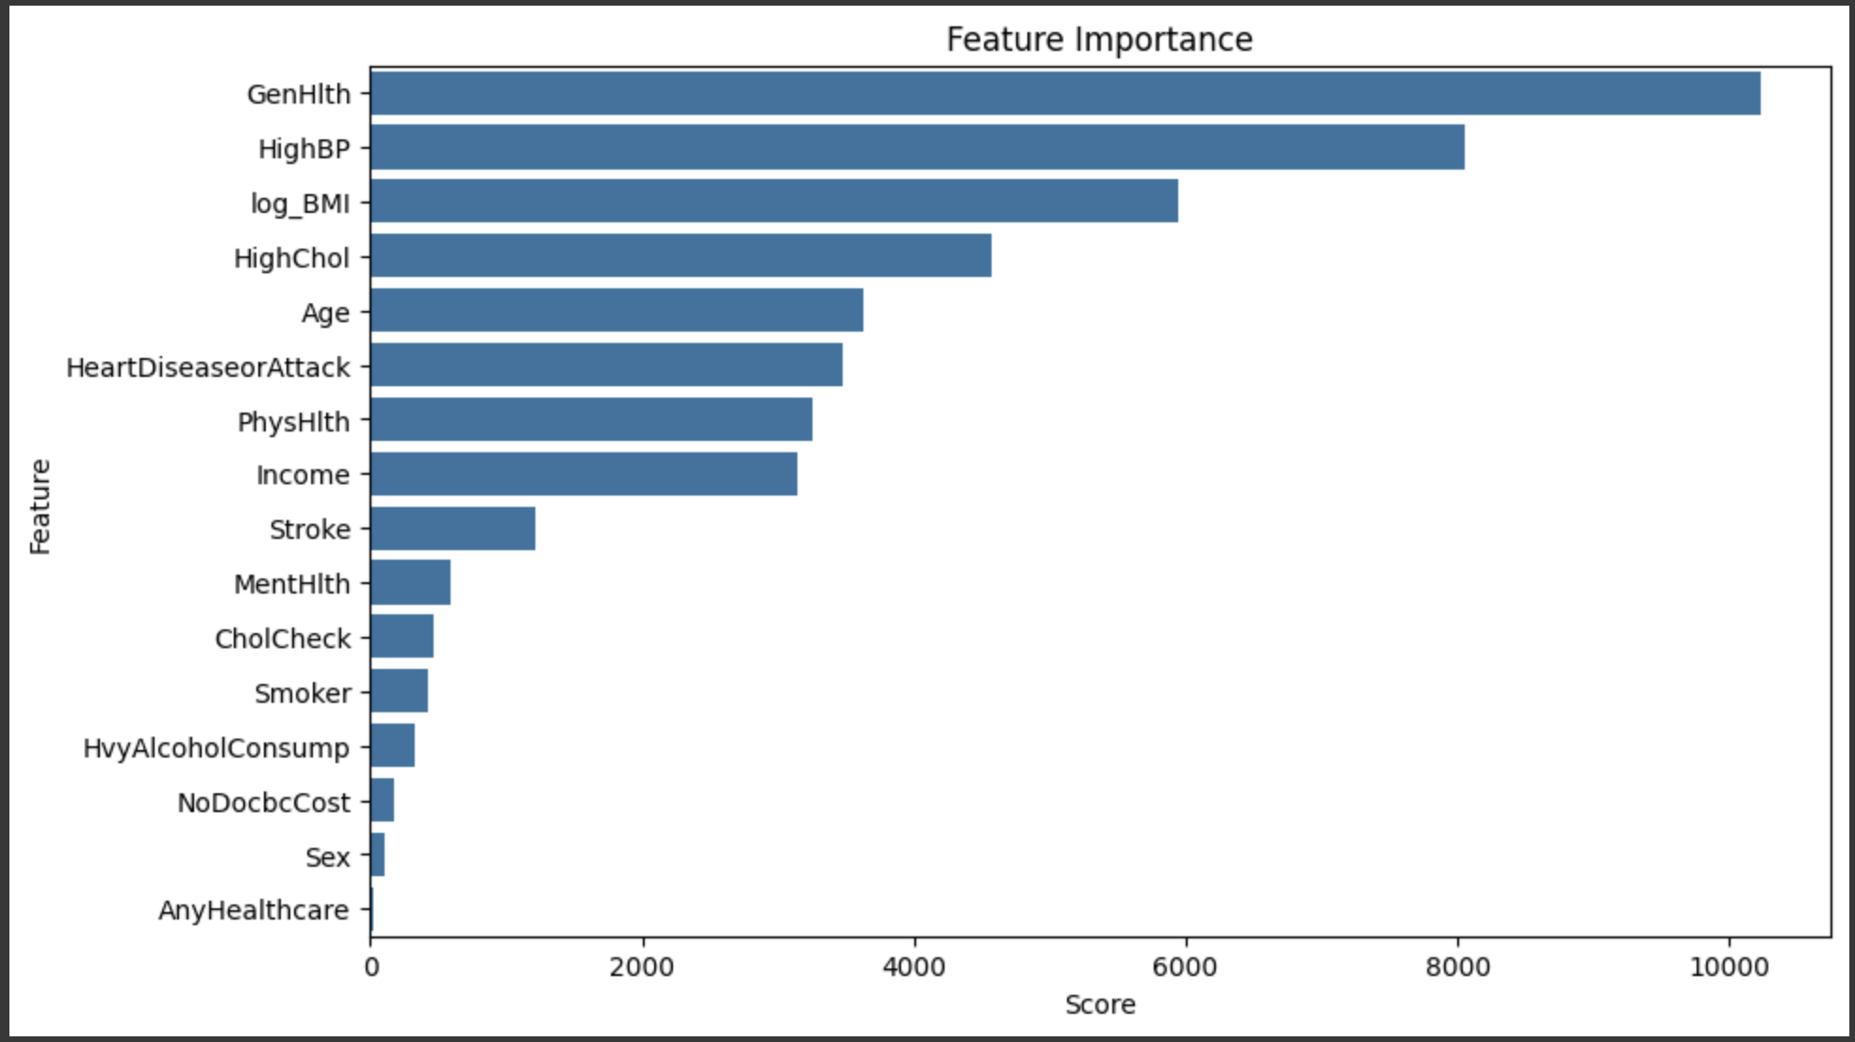
K-NN - Feature Importance
GenHlth, High_BP are the two biggest features of importance for this K-NN model
These features align much more with actual procedures to predict diabetes in real world.
Notes:
Observations:
Considering HighBP, around 30% people are diagnosed with diabetes.
People with histoy of heart disease or heart attack have around 35% chances of getting diabetes.
Considering sex, we can see both male and female population are equally diagnosed with diabetes.
People with high cholestrol have a 20% chance of getting diabetes.
People with or without any kind of healthcare have a lesser chance (<20%) chance of getting diabetes.
Smokers show greater than 20% chances of getting diagnosed with diabetes.

Slide 15

Recommendation
Implement the Logistic Regression model for diabetes prediction, prioritizing precision and accuracy.
Optimize model parameters to reduce false positives and improve patient outcomes.
Consider integrating the model into existing healthcare systems to enable early detection and treatment.
The model can be used to identify high-risk individuals, enabling targeted interventions and prevention strategies.

Slide 16
Conclusion
Below table shows comparison between the two models
Model | Accuracy Score | Precision Score | Recall Score
Logistics Regression | 85% | 0-86% 1-0% 2-53% | 0-98% 1-0% 2-18%
K-NN | 83% | 0-87% 1-2% 2-42% | 0-95% 1-0% 2-23%
Better Model | Logistic Regression | Logistic Regression | Logistic Regression
Logistic Regression is performing better for most parameters. Health Industry can use logistic regression model to predict and detect diabetes.

Slide 17
Thank you

